Slide 1



PROSTAID CALGARY
Serving Calgary & Area
Since 1993
your local voice of prostate cancer
Inform, mutual help, and advocate for men and their families about prostate cancer
www.pccncalgary.org
www.youtube.com/user/pccncalgary
Monthly Meetings
The Digital Examiner
Website
YouTube Channel

Slide 2
Tonight’s Agenda
your local voice of prostate cancer
Welcome and Introductions
Who Are We?
The Fine Print
Tonight’s speakers reporting on PCa Journey & PCRI Conference
Announcements, questions, and visiting

Slide 3

Who Are We?
your local voice of prostate cancer
A self funded, registered non-profit organization
For >20 years, helping men and their families deal with prostate cancer
Membership: >1000 men & caregivers
Board of Directors and an Executive Director
Affiliations: Prostate Cancer Canada, Prostate Cancer Centre, Tom Baker Cancer Centre, AB Cancer Network, Alberta Prostate Cancer Research Initiative, Wellspring Calgary, Univ. of Calgary

Slide 4
Membership
your local voice of prostate cancer
We provide education, mutual help, and advocacy:
  Membership is free
  Focus Groups:
  Newly Diagnosed/Active Surveillance – before primary treatment
  Warriors – cancer has returned after treatment
  Wives, Partners, and Caregivers
  Peer-to-Peer discussion
  Distribute The Digital Examiner to >1300
  > 90 Videos of meetings on our web site and at www.youtube.com/user/pccncalgary

Slide 5
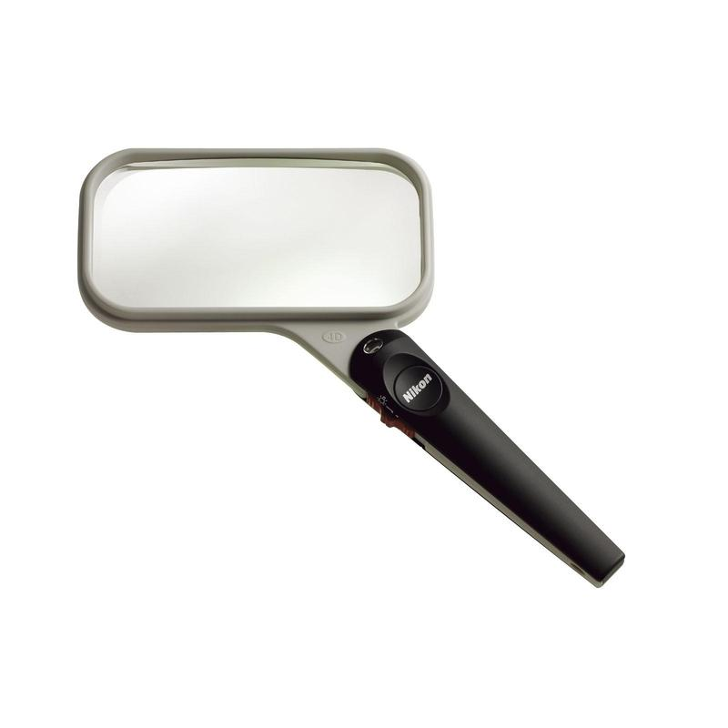
Here’s the Fine Print!
your local voice of prostate cancer
Be well informed in consultation with your medical team before deciding on a treatment and to minimize issues of over-treatment
We do not give medical advice, endorse or recommend treatments, medications, or physicians
Controversial ideas may be expressed, but consult a qualified healthcare professional before making medical decisions
Notes:
Through our various activities and publications we encourage gaining a good understanding of PCa and the available treatment options. We encourage seeking medical advice from health care professionals before making any decisions relating to PCa.

Slide 6
How to help us
your local voice of prostate cancer
Donations – ppcn.org
Spread the word about us
Invite/bring friends to our meetings
Introduce us to donors

Slide 7
Announcements
your local voice of prostate cancer
Prostate Cancer Foundation BC and the BC Support Groups
Symposium, September 23 - 25, 2016 Vancouver
Registration Fee: Registration closes August 1
EARLY - MAY 31 $150.00, REGULAR - JUNE 1 - JULY 31 $175.00
Accommodations
Conference at the centrally located Holiday Inn on Broadway in Vancouver. 604-707-1939.
Please use group code PCF when making your reservation. Room rate is $165.00 per night. kevbevhiggins@gmail.com
Online registration is at www.prostatebc.ca/events.
Or call the Prostate Cancer Fdn BC office for assistance at 604-574-4012

Slide 8
Announcements
your local voice of prostate cancer
Prostate Cancer Research Institute Conference
Saturday, March 26, 2016 at LAX Marriott Hotel
An Update On Active Surveillance + Treating Sexual Side Effects in Prostate Cancer
08:00 - 10:00 AM - On Site Registration Open
10:00 AM - 12:00 PM - Laurence Klotz, MD - The Status of Active Surveillance in 2016 + Q&A
12:00 - 01:00 PM - Lunch
1:00 - 3:00 PM - Mohit Khera, MD - New Approaches in the Treatment of Male and Female Dysfunction: Testosterone Therapy & Other Options + Q+A
3:00 - 4:00 PM - Mark Moyad, MD & Mark Scholz, MD - Extended Q+A
Registration $25
4:00 - 6:00 PM - Dinner
6:00 - 8:00 PM - “A Man and His Prostate” A Play Starring Ed Asner $25

Slide 9
Announcements
your local voice of prostate cancer
Dr. Pablo Santos and Dr. Lauren Walker
Department of Oncology, University of Calgary
A team of researchers, led by Dr. Lauren Walker, at the University of Calgary are conducting a study on male sexual distress.
In order to recruit participants for our study a notice will appear in The Digital Examiner or you may wish to contact
Dr. Santos at
Pablo.Santos@ahs.ca or 403-698-8001

Slide 10

Announcements
your local voice of prostate cancer
Annual General Meeting May 10th
Election of board of directors
Exec. Director – Kelly Fedorowich

Slide 11
March Meeting
your local voice of prostate cancer
See you at our next regular meeting
Tuesday, March 8th at 7:30 PM
Kerby Centre
Dr Siraj Hussain, TBCC
Pre-meeting programs at 6:30 PM
Notes:
The Pathfinder’s Award is given to a person who has made a significant contribution to the lives of prostate cancer patients and their families.

Slide 12
Tonight’s Presentations
your local voice of prostate cancer
A Personal Journey & Prostate Cancer Research Institute Conference September 2015
  Rick Brown – Conference summary
  Willem Smink – Metatstatic PCa treatment
  Bob Dixon – Active surveillance
  Stewart Campbell – My 8-year PCa journey

Slide 13
Castrate Resistant PC Treatment Options
Willem Smink

Slide 14
My History
Radical Prostatectomy – Dec 2007
Radiation Treatment – July 2009
Androgen Deprivation Therapy – Oct 2013
The PCRI Conference would be a good way to find out about the latest treatment options for castrate resistant prostate cancer

Slide 15
Initial ADT Treatment
Initial standard treatments
  Eligard (leuprolide)
  Orchiectomy
Both options reduce androgen levels
Have been in use for many years

Slide 16
Some Current ADT Options
Abiraterone – lowers androgen levels
Enzalutamide – inhibits androgen receptors
Clinical research as to how best apply these drugs is on going.
  Should they be used earlier?
  What sequence?
  In combination with other drugs?
The rapid advancement from the laboratory to the clinic shows what is possible when a clear understanding cancer biology is effectively applied.

Slide 17
Chemotherapy
Some chemotherapy options
  Taxotere (Docetaxel) – well established
  Jevtana (Cabazitaxel) – an improved Taxotere
Ongoing research
  Lupron/Taxotere combinations
  Carboplatin/Taxotere – used for lung cancer but is being investigated for PC
  Both have shown good results

Slide 18
Immune Therapy
Provenge –It is a personalized treatment that works by programming a patient's own immune system to seek out cancer spreading in the body, and attack it as if it were foreign. It must be prepared specifically for each patient. Expensive ~$100,000
Prostvac – Phase 3 study. The study’s secondary endpoint demonstrated that patients who received PROSTVAC had a median overall survival that was 8.5 months longer than the control group (25.1 versus 16.6 months) and a 44% reduction in the risk of death

Slide 19
Radiation
Xofigo – Radium 223
  Used for castration-resistant prostate cancer with symptomatic bone metastases and no known visceral metastatic disease
  Binds with the bones at the site of PC
  Approved for use in Canada in 2015

Slide 20
There have been more drugs approved by the US Food and Drug Administration for the treatment of castration resistant prostate cancer in the past 5 years than in the prior 3 decades.

Slide 21
Bob Dixon / Sharell Kopp
Bob’s journey
  Both my father and grandfather had prostate cancer
    When my grandfather (in his 80s) was diagnosed, the doctor told my father first. My father said “don’t tell him, the news will kill him”. My grandfather died at age 95.
    My father had prostate issues in his 50s, but put off dealing with it. Prostate cancer diagnosis was too late, the cancer had progressed. He died at age 67 of prostate cancer-related liver cancer, 8 years after diagnosis.
  I had regular checkups through my 40s and 50s. I had my first two biopsies in the summer of 2012; the first indicated inconclusive results, and was repeated. 2 of the 12 samples were abnormal, a Gleason 6. I was 55. A repeat biopsy in the summer of 2013 had a similar result.
  I am on Active Surveillance. My PSA trend has been erratic, to a maximum of 6.3. The latest test, two months ago, was 2.8. I have my next appointment in the summer of 2016.

Slide 22
The Prostate Cancer Journey
Microscopic Localized to organ Regional spread Metastatic spread Degree of Cancer
Active
Surveillance
Early local therapy
Systemic therapy
Multimodal therapy
Type of treatment
PSA test
PSA test
PSA test
PSA test
PSA test
PSA test
PSA test
imaging
imaging
imaging
imaging
imaging
imaging
Active
Surveillance
Adjuvant/Salvage
Therapy
Diagnosis
Pre diagnosis evaluation
biopsy
biopsy
biopsy
biopsy
biopsy
biopsy
biopsy
Definitive
Treatment
Terminal
Diagnosis
Bob’s journey, so far
Modified from Dr. John Mulhall, 2014 PCRI conference, and then updated as I learn new information

Slide 23
This is not a bad trend
Age 55
Age 59

Slide 24
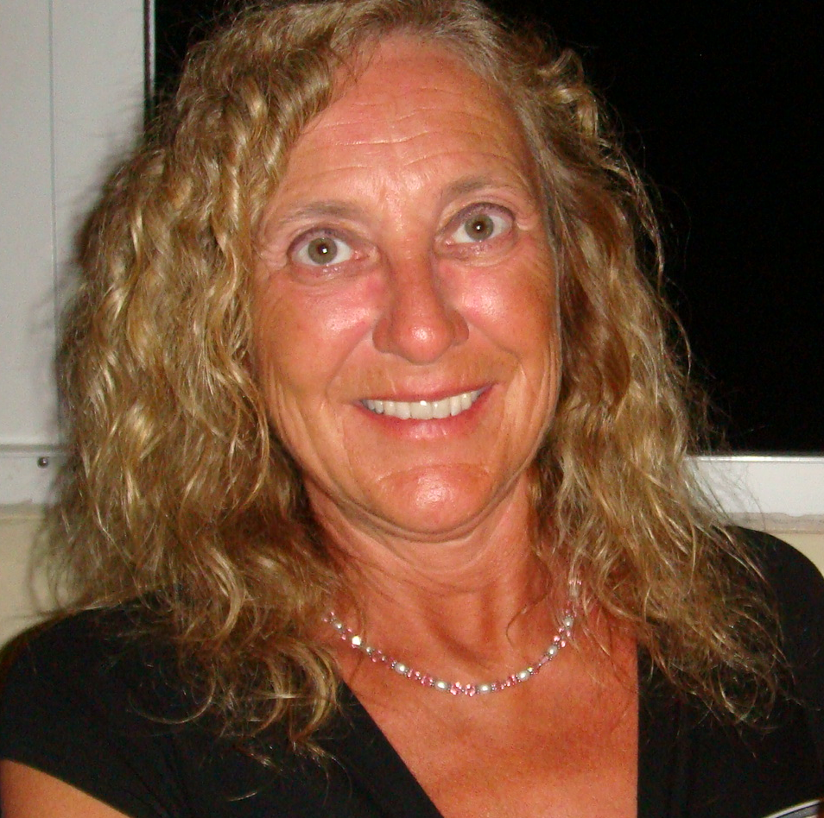
Bob Dixon / Sharell Kopp
Sharell’s journey
  Introduction
  Thank you to PCCN-Calgary for sponsorship
  PCRI 2015 Prostate Cancer Conference
    Women’s workshop session
    Insights and knowledge
    Provided an opportunity for “fun”
???

Slide 25
Bob Dixon / Sharell Kopp
Bob’s thoughts from the 2015 PCRI conference
  As with the 2013 and 2014 conferences, an almost overwhelming amount of information was available
  Triaging the information was important: what was ‘mandatory’ for attendance, what was optional, what was unnecessary
  We have developed a focus on active surveillance issues – in line with my current PCa status
  Issues related to recurrent cancer, heavy duty drugs, repeat radiation, etc. are of lesser importance for us now
    I intend to be on active surveillance for a long time
    If those other issues (the deeper shades of blue) become important, I will get to them - then
    With the current rate of R&D, what’s relevant now will have been supplanted with new learnings by then

Slide 26
Bob Dixon / Sharell Kopp
    New Technologies
    Sexual Side Effects
    Active Surveillance
    Prostate MRI Imaging
    Chemotherapy
    Hormone Treatments
    Radiation Therapy
    MRI Prostate Imaging
Conference schedule
  Friday:
    Workshops
  Saturday:
    Zytiga and Xtandi
    Immune Therapy
    Seed Implant Radiation
    Chemotherapy (New Drugs)
  Sunday:
    General Session Review
    Active Surveillance
    PET CT Prostate Imaging
    Sexual Function
Workshops targeted; New Technologies open for all
The core of the conference – individual speakers on specific topics
Each session presented twice – so, choose any two to attend

Slide 27
Bob Dixon / Sharell Kopp
Bob’s thoughts from the 2015 PCRI conference
  Much more info, than before, on the predictive ability of genetics analysis, or ‘genomic profiling’ (Prolaris, Oncotype DX, Decipher ...)
  A lot of the material was repetitive from previous conferences or other sources; a good thing, because repetition improves the learning process
  For me, the workshop sessions (on Friday afternoon and Sunday morning) were nearly as valuable as the mainstream sessions on Saturday). Unfortunately, the workshop sessions are not included in the video set.
  I captured more than 100 photo images of the slides (iPhone)
My focus is on Active Surveillance / Imaging

Slide 28
Bob Dixon / Sharell Kopp
Bob’s selection of takeaways from the 2015 PCRI conference (not necessarily truths)
  Miscellaneous
  “The 2nd opinion of a pathologist is more important than a 2nd opinion from a urologist”
  After (any) treatment, “the only way you will know if your cancer is controlled is by PSA measurement”
  “PSA Control is the only measure that should be used to compare Primary Treatments” – not years-to-live statistics

Slide 29
Bob Dixon / Sharell Kopp
Bob’s selection of takeaways from the 2015 PCRI conference (not necessarily truths)
  Drug Therapies
  For hormone resistant disease: Sipuleucel-T (Provenge), Enzalutamide, Abiraterone, Docetaxel, Cabazitaxel, Radium223 – big names for big drugs – either on their own or in combination therapies
  Re Chemotherapy: “improved outcomes result from discovery of new, effective agents; earlier use of effective agents; and earlier us of effective agents, in combination”

Slide 30
Bob Dixon / Sharell Kopp
Bob’s selection of takeaways from the 2015 PCRI conference (not necessarily truths)
  Brachytherapy
  “Seed implant radiation, for low risk disease, is 10% better for cancer control than surgery and 20% better than modern high dose IMRT treatment”
  “For medium risk disease, combination of EBRT and brachytherapy is 30% better than surgery” (Ascende trial)
  “For high risk disease, surgery has worse results”
  With regard to radiation treatments, “technique does not cure cancer, dose does”
  Discussion of temporary vs permanent seeds: “temporary seeds – one isotope, removed after a few days, more difficult installation procedure”
  Brachytherapy not done as often anymore because it is not as profitable for the providers”

Slide 31
Bob Dixon / Sharell Kopp
Bob’s selection of takeaways from the 2015 PCRI conference (not necessarily truths)
  Sexual Function
  “Understand what your treating physician means by ‘erectile function recovery’”
  “Sexual health – the number one area of regret of patients after treatment”
  “ADT is the most penis threatening thing you can be exposed to … think seriously in terms of ‘Survival Benefit’”
  “Penile injection therapy sounds awful … best drug therapy we have for erectile dysfunction”
  “Let us not focus solely on adding ‘years to life’, but also pay attention to adding ‘life to years’”
For me, sex is a good thing

Slide 32
Bob Dixon / Sharell Kopp
Bob’s selection of takeaways from the 2015 PCRI conference (not necessarily truths)
  Active Surveillance
  “Low risk disease does not need treatment, high risk disease does need treatment”
  “Active Surveillance maintains intent to cure if necessary”
  “Active Surveillance is appropriate for men of all ages”
  “Active Surveillance requires reliable follow-up”
  “Gleason 3+3 rarely progresses”
  “But, Gleason 3+3 now is often called Gleason 3+4”
  Risk assessment is the ultimate need: quality biopsies, imaging (MRI or other) and genomics or other markers – no magic bullet
  “Active Surveillance is gaining in the real world”
Active Surveillance – part of the cure for overtreatment

Slide 33
Bob Dixon / Sharell Kopp
Bob’s selection of takeaways from the 2015 PCRI conference (not necessarily truths)
  MRI
  “For patients with low volume, low grade disease, MRI provides two advantages: screening missed areas and baseline imaging”
  “Resolution and contrast superior to ultrasound and CT scans”
  “MRI not as effective at identifying low grade cancer in patients that have been treated for BPH”
  “MRI-fusion biopsy may be helpful in the right hands”
  “Up to 20% of men with a ‘negative’ MRI will have some cancer”
  “However, the false negative rate is lower for MRI than systematic biopsy”
  “Some potentially important cancers (15-30%) are MRI-invisible”
Relatively expensive, and needs trained practitioners

Slide 34
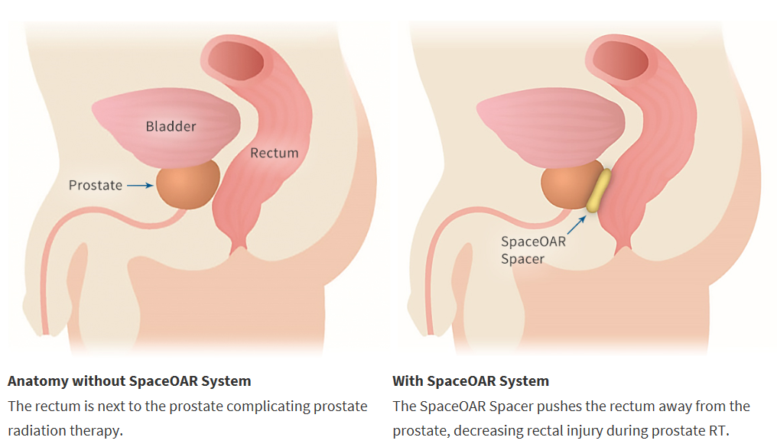
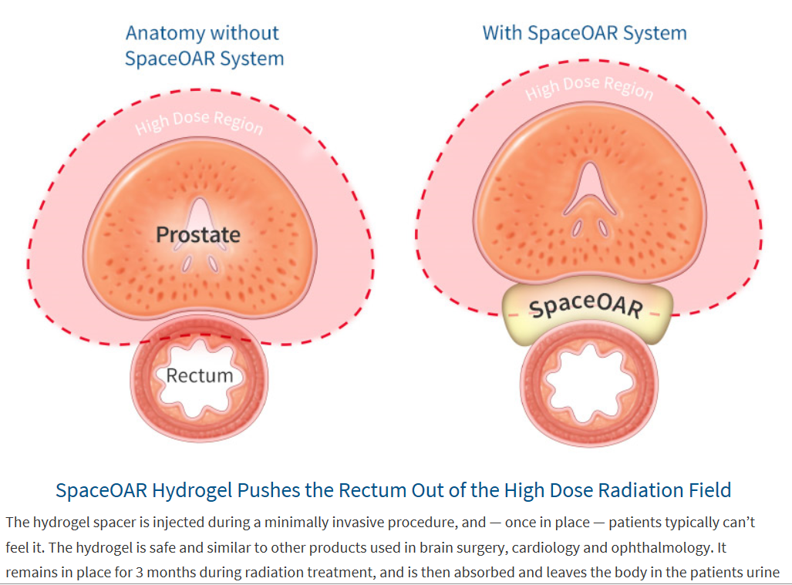
Bob Dixon / Sharell Kopp
SpaceOAR
  Augmenix, Inc.
  FDA approval, 2015-04-01
  SpaceOAR System reduces rectal injury in men receiving prostate cancer radiation therapy (RT) by acting as a spacer – pushing the rectum away from the prostate
  www.spaceoar.com

Slide 35
Bob Dixon / Sharell Kopp
Summary
  Massive amount of information – sometimes daunting
  But, I feel better about it. I am much more comfortable now, with my increased understanding of my disease and its probable progression(s)
  Thanks to Prostaid Calgary for sponsorship

Slide 36
Prostate Cancer Research Institute
Sept 11-13, 2015
Los Angeles, USA
For almost 20 years, the PCRI has been working to improve the quality of men’s health by supporting Prostate Cancer research and education for patients, their families and the medical community.
www.pcri.org
ProstateHelpline
1 800 641 7274
Email: help@pcri.org

Slide 37
My Journey Living with Prostate Cancer
Initial Diagnosis & Treatment Strategy
Visited family doctor late Feb, 2017 with lower back pain.
Checkup determined:
  Abnormal DRE and PSA of 61.49.
Referred to Rapid Access Clinic – April 12, 2007
  Prostate biopsy
    Gleason grade 4 + 4 = 8; 5 of 10 cores; 15% of gland;
    Gland volume = 41; PSAD = 1.49.
  CT scan - several swollen lymph nodes
  Bone scan – no active bone metastasis
  Consults with PCCentre urologist and TBCC radiation oncologist
Diagnosis – high risk disease with retroperitoneal and left sided pelvic lymphadenopathy
Treatment options:
  Surgery and radiation not curative, only palliative. Ouch!!
  Medical oncology treatment strategy.

Slide 38
Nodal Disease
Bone Scan – Dec 18, 2013
  No active bone metastasis
CT Scan – Dec 18, 2013
  3 regions of successive progressive enlargement of lymph nodes in the pelvis and retroperitoneum
  Worrisome for metastatic disease
Swollen lymph nodes – earlier they were 2X – 3X this size
  Left external iliac node – 11.8 mm.
  Left common iliac node – 12.0 mm.
  Paracaval node – 8.0 mm.
Prostate gland
  Small and well defined
  Size unchanged
  No evidence of expansion to the pelvic sidewall
Disease status - consider metastatic until proven otherwise

Slide 39
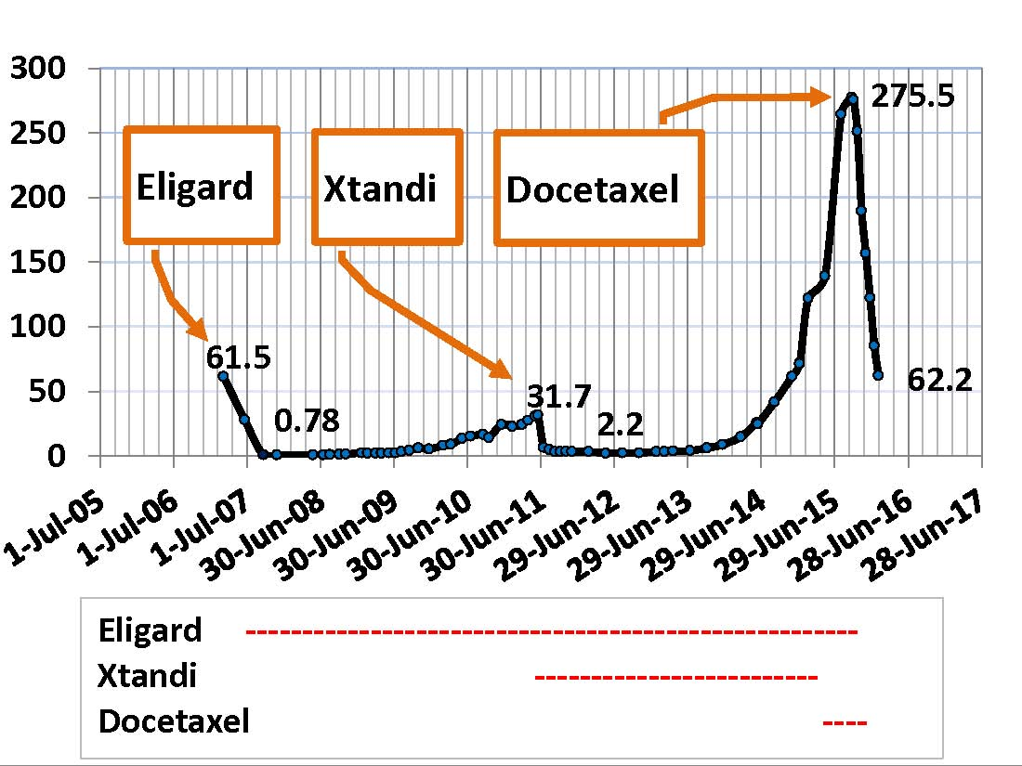
Effects of Drugs on My PSA

Slide 40
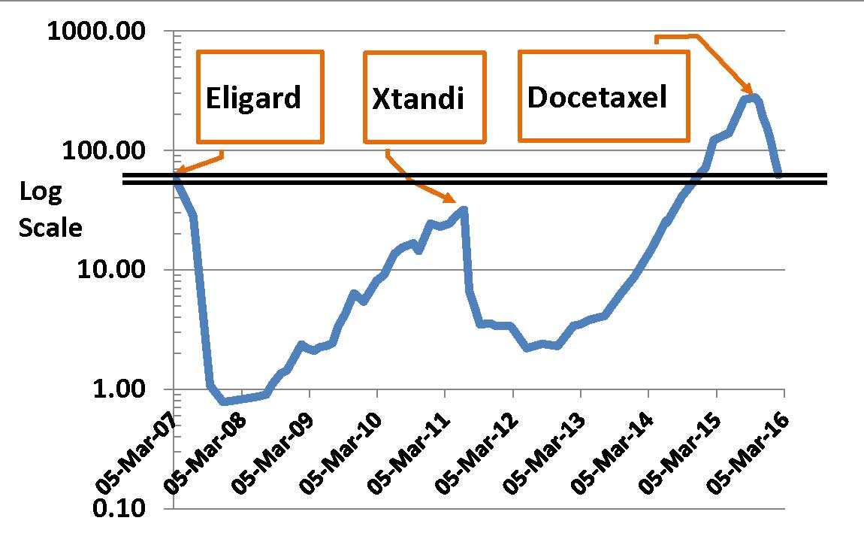
Effect of Drugs on Log 10 PSA

Slide 41
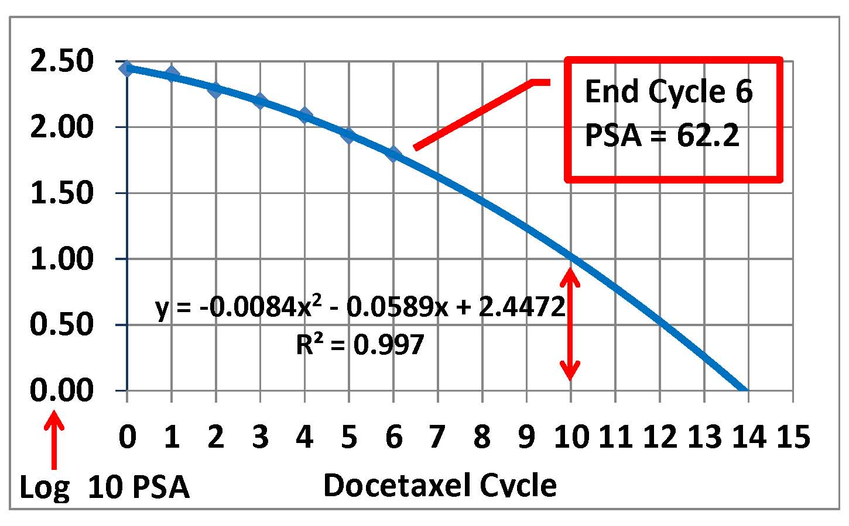
Projections for PSA
After 10 & 14 Cycles of Docetaxel

Slide 42
What’s on the Horizon?
Current trend with PSA decline is my friend, until:
  Down-trend in PSA decline is broken
  Resistance to docetaxel develops
  Toxicities to docetaxel become significant
Chemo holiday (Hurray!!) – just in time for the summer
Follow-up Options to 10 Scheduled Chemo Treatments:
  Keep the pressure on – have an additional 1 – 4 chemo treatments
  Closely follow PSA, PSA doubling time and radiographic progression (CT scans) once chemo is finished
  If PSA rises, re-challenge with docetaxel, if tolerable
  Sequence with new therapies, if available
  Sequence with Jetvana (cabazitaxel) – alternative chemo agent
Keeping active and enjoying life!!

