Slide 1
Blood and Tissue Based Molecular Signatures in Predicting Prostate Cancer Progression
Tarek A. Bismar, MD
Professor, University of Calgary
Departments of Pathology-Laboratory Medicine, Oncology, Biochemistry and Molecular Biology

Slide 3
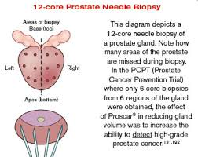
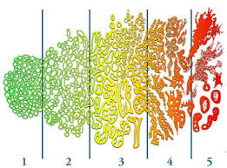
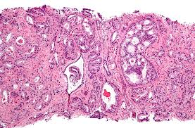
Role as Surgical Pathologist

Slide 4
Prostate Cancer
One of the common cancers affecting men in western world
PSA remains a major screening tool and the most widely used serum biomarker
PSA is not ideal as it overlaps between BPH and PCA (est 15% of men with PSA<2.5 will have PCA)

Slide 5
Current treatment Options
Surgery
Radiotherapy
Active surveillance
Hormone and Chemotherapy (advanced CRPC)
Specific targeted therapy for more rapid disease

Slide 6
Known Molecular Markers
ERG: expressed in about 50% of surgical cohorts
PTEN: deleted in about 45%-60% of localized and metastatic PCA
SPINK1: expressed in about 15% of PCA
RAF: rearranged in about 2% of CRPC
MYC: amplified in about 5%
AUKRA: amplified in about 5%
SPOP: mutated in 6-15%
AMACR: overexpressed in about 95% of PCA

Slide 7
TMPRSS2-ERG in PCA
TMPRSS2-ERG transcripts have been identified in urine samples of PCA patients
TMPRSS2-ERG fusion detected in blood samples and circulating tumor cells of patients with advanced PCA
New urine tests being developed for better detection of PCA and significant PCA

Slide 8
Serum PSA
This should be carried out with DRE and consultation with urology to assess for various risk factors
Absolute value is important, but also PSA doubling time and potentially PSA density

Slide 9
Active Surveillance
Patients with low/low intermediate risk can be managed with such programs
GS6/ 3+4 with 3 or less positive cores and PSA < 10
10-30% of such patients may exist AS programs due to disease progression or patient's anxiety
ERG and PTEN suggested to have a role in predicting progression (Current Prostate Centre Study)

Slide 10
2nd Line drugs for Advanced PCA
Current new hormonal drugs are being developed and used such as enzu, abi, +/- Docetaxol and new research to investigate patients responsive/ resistant to such drugs are being conducted

Slide 11
Role as Scientist
Develop molecular signatures for aggressive and indolent PCA that can be implemented clinically to aid in better decision making for patients

Slide 12
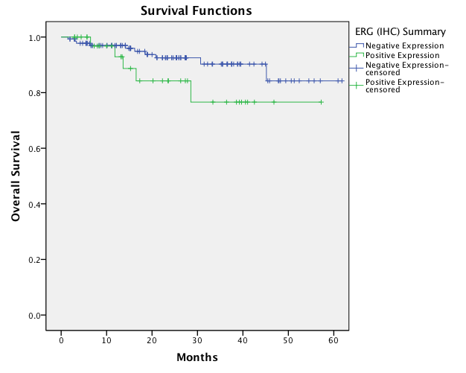
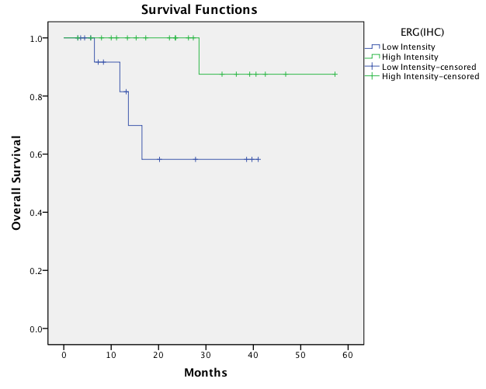
A. Overall survival of PCA patients with ERG positive and negative tumours not subjected to hormonal treatment (n=177, p=0.15). B. Overall survival difference of High vs. low ERG expression to in subgroup of patients not subjected to hormonal therapy (n=37, p=0.02)
ERG protein expression reflects hormonal treatment response and is associated with Gleason score and prostate cancer specific mortality.
Bismar TA, et al, Eur J Cancer. 2012 Mar;48(4):538-46
A
B

Slide 13
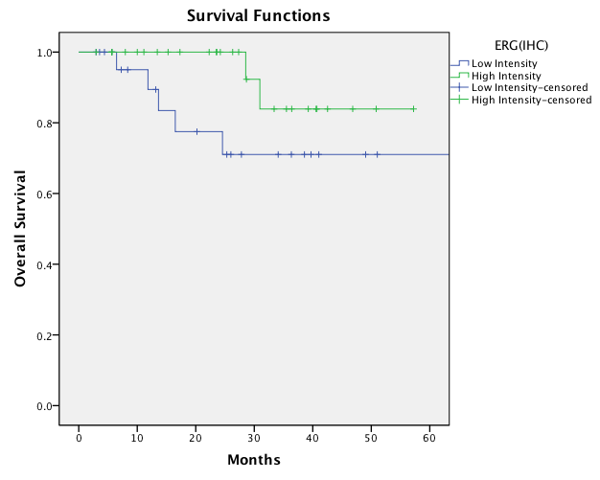
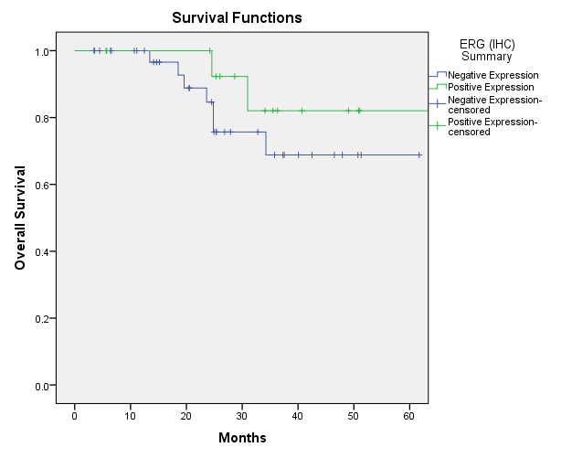
C. Overall survival difference of High vs. low ERG intensity in the overall PCA cohort not subjected to prior hormonal therapy, regardless of type of treatment implemented (n=53, p=0.11). D. Overall survival of ERG expression in CRPC subgroup treated by LH-RH agonist (n54, p=0.31)
ERG protein expression reflects hormonal treatment response and is associated with Gleason score and prostate cancer specific mortality.
Bismar TA, et al, Eur J Cancer. 2012 Mar;48(4):538-46
D
C

Slide 14
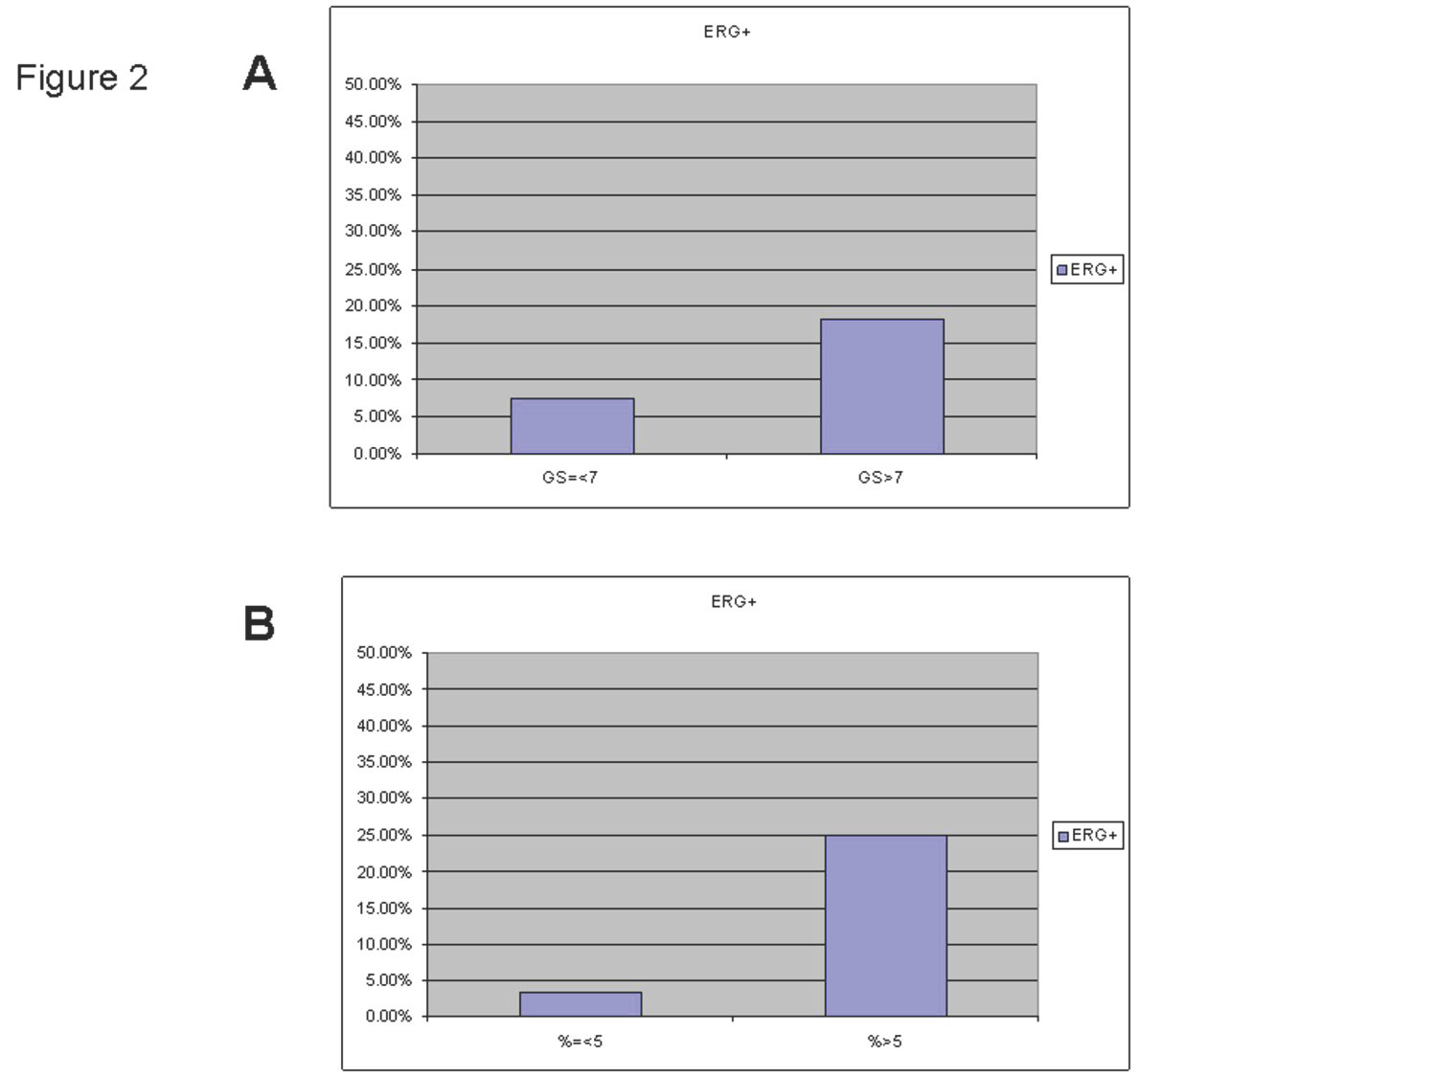

Slide 15
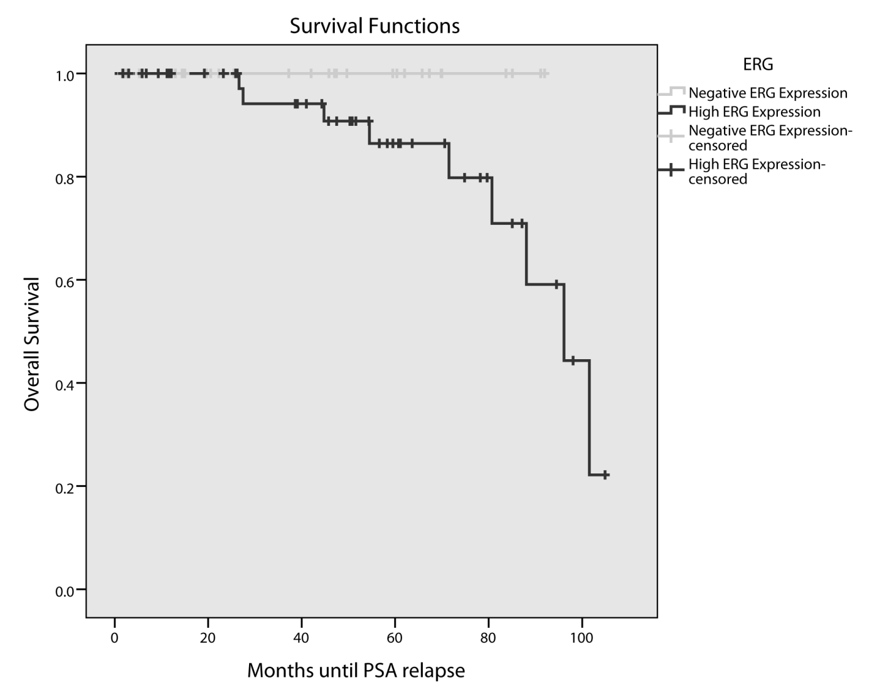
ERG in PCA <50 at Surgery

Slide 16
PTEN Deletions in PCA
PTEN deletions have been associated with disease progression and higher Gleason score and with clinical outcome in clinically localized and watchful waiting cohort
The rate of one loss of PTEN gene is higher compared to complete deletion of both alleles, with the latter increases with increased GS

Slide 17
ERG, SPINK1 and PTEN

Slide 18
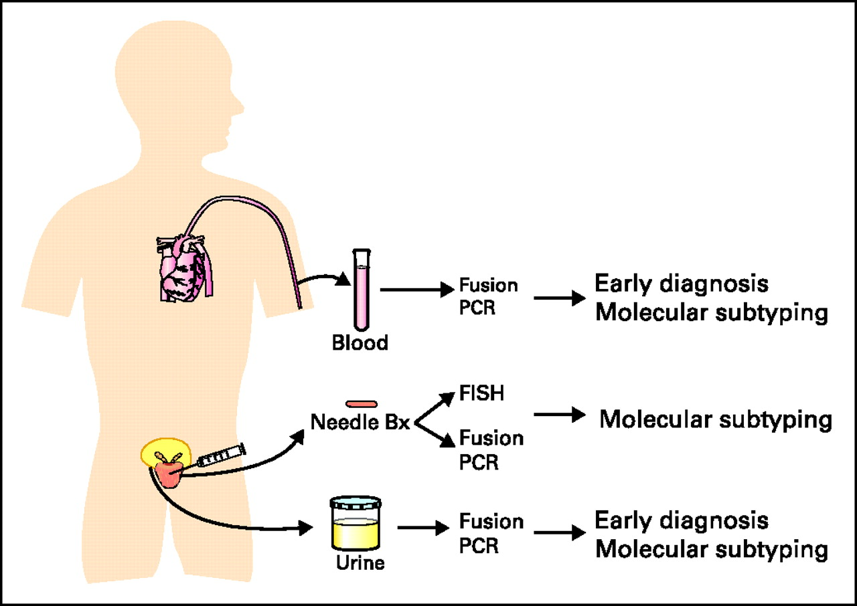
Diagnostic Gene Signatures
The diagnostic predictive and prognostic implication of ETS fusion prostate cancer.
Rubin M A et al. JCO 2011;29:3659-3668
©2011 by American Society of Clinical Oncology
Notes:
The diagnostic predictive and prognostic implication of ETS fusion prostate cancer. The fusion of two genes to form a novel chimeric mRNA transcript represents a unique opportunity to develop a diagnostic test. Recent studies have demonstrated that the fusion transcript can be identified in the serum and urine from men with prostate cancer. The urine assay is being developed commercially with the goal of establishing a highly specific test. Prostate tissue derived from clinical biopsies, transurethral resection of the prostate samples, or radical prostatectomies can be used to detect the ETS rearrangement events by using fluorescent in situ hybridization (FISH) or reverse transcriptase polymerase chain reaction (PCR). The identification of ETSrearrangements may have prognostic implications in specific settings (eg, an active surveillance clinical trial) and may also be predictive of response to targeted therapies such as those targeting the androgen receptors. The significance of these clinical assays will largely depend on future studies that determine to what extent ETS rearrangement prostate cancers behave differently from nonrearranged prostate cancers. Bx, biopsy.

Slide 19
Tissue Based and blood Based Signatures
Decipher
PCA Oncotype DX
Cell cycle signature
TMPRSS2-ERG/PCA3 (urine)
Potential tissue based (ERG, PTEN in AS)
Our own HDDA10 gene signature for AS and for predicting neuroendocrine differentiation post XRT/HR therapy (projects at the Prostate Centre Calgary)

Slide 20
Neoplasia 2006 Jan;8(1):59-68
Notes:
20

Slide 21
Outcome TMA

Slide 22
Prognostic Gene Signatures
Ability to discriminate between indolent and aggressive tumors
Must be better and cost effective compared to current methodology of Gleason score and needle biopsy
Ability to add to Gleason score or discriminate between two similar Gleason scores

Slide 23
Prognostic Gene Signatures
Must be able to utilize minimal amount of tissue (e.g. Needle biopsy of patients eligible for active surveillance)
Must account for tumor heterogeneity generating stable score
Preferably able to generate a signal from benign tissue reflective of adjacent tumor

Slide 24
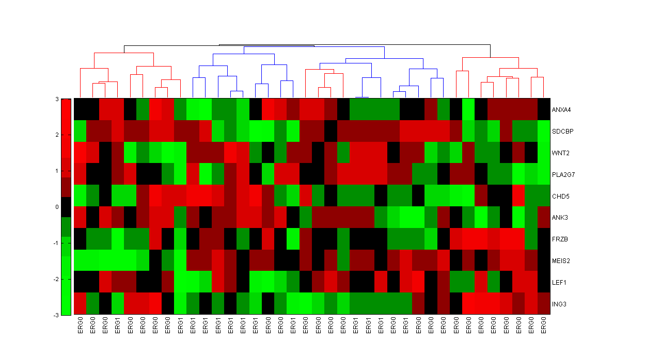
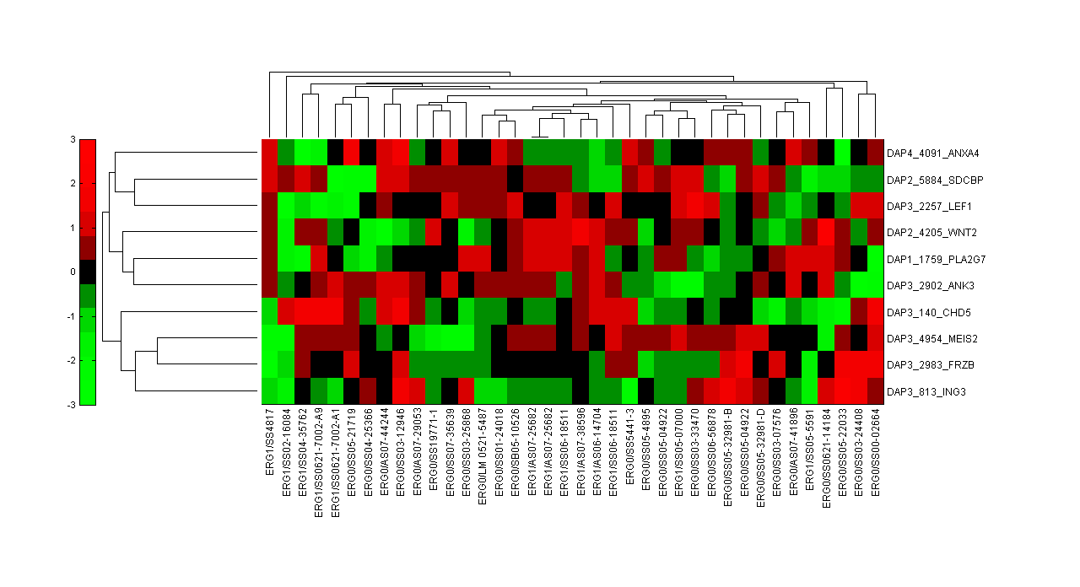
10 gene signature relative to ERG gene rearrangements (76% accuracy)
Red, high expression, green=low expression and black no change
Cluster, red ERG negative; blue, ERG positive
Bismar, TA et al, BJUI 2013 IN PRESS

Slide 25
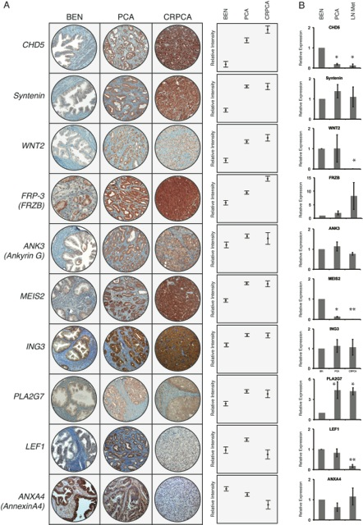
Association to disease progression
A. Protein and B. mRNA

Slide 26
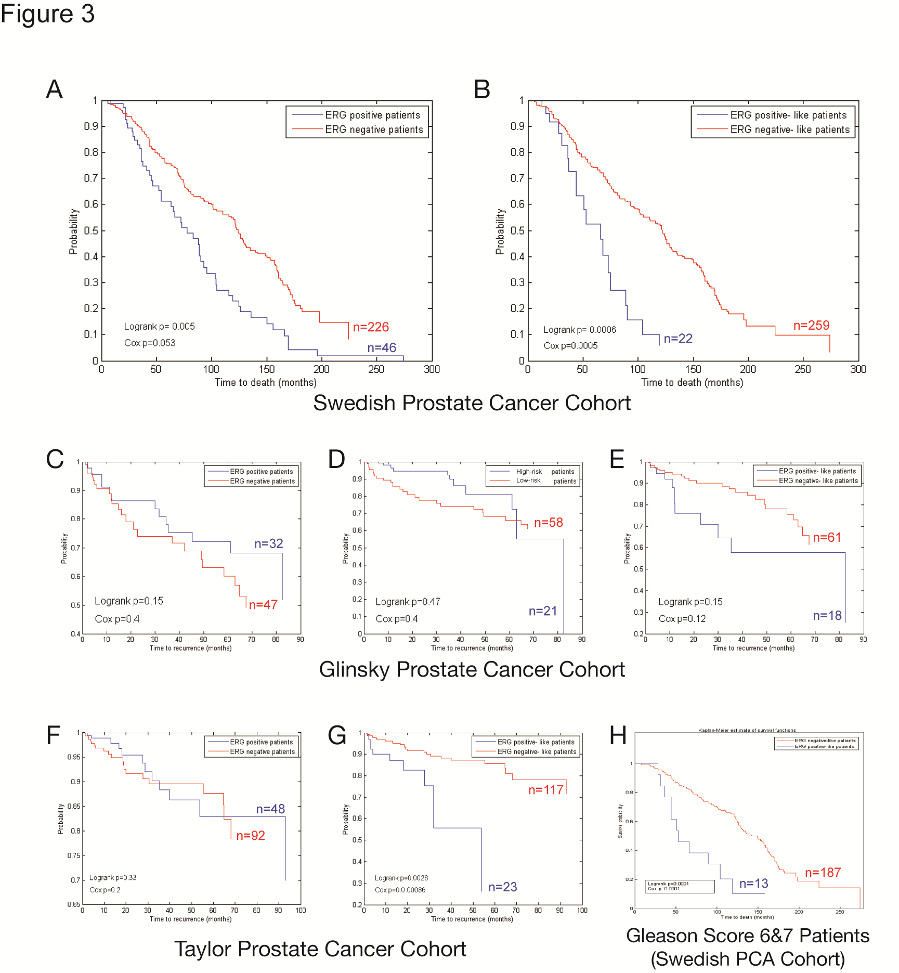

Slide 27
Swedish Cohort
 | Group | Number of Samples |  | HR (95%CI) | p-value/Cox value
GS 7 Patients | GS 7 alone | GS 7(3+4) | GS 7(4+3) | 2.23 (1.5-3.5) | 2x10⁻⁴/2.4x10⁻⁴
 |  | 79 | 38
 | GS 7 + ERG | GS 7(3+4) AND ERG0 | GS 7(4+3) OR ERG1 | 1.8 (1.4-2.5) | 9x10⁻⁴/5.6x10⁻⁵
 |  | 61 | 44
 | GS 7 + ERG-like | GS 7(3+4) AND ERG0-like | GS 7(4+3) OR ERG1-like | 2.52 (1.6-3.4) | 3x10⁻⁵/6.2x10⁻⁶
 |  | 72 | 45
GS 6+7 Patients | GS 6+7 alone | GS 6 +GS 7(3+4) | GS 7(4+3) | 3 (2-4.5) | <10⁻⁷/5.3x10⁻⁸
 |  | 162 | 38
 | GS 6+7 + ERG | GS 6 +GS 7(3+4) AND ERG0 | GS 7(4+3) OR ERG1 | 1.5 (1.2-2) | <10⁻⁵/5x10⁻⁵
 |  | 136 | 46
 | GS 6+7 + ERG-like | GS 6 +GS 7(3+4) AND ERG0-like | GS 7(4+3) OR ERG1-like | 3.2 (2.1-4.1) | <10⁻¹⁰/7.5x10⁻¹¹
 |  | 153 | 45

Slide 28
Validation of 10-Gene molecular signature in PCA patients
UC Active surveillance eligible cohorts

Slide 29
Figure 5
HDDA10 and DECIPHER scores across multifocal cancer of same patient and in advanced disease
AdvPCa.GS9
Pattern 4 cords
AdvPCa.GS9
cribriform with comedo
CA.GS6
Foamy type PCA,large glands
AdvPCa.GS9
Solid sheets
CA.GS7(3+4)
AdvPCa.GS9
CA.GS7(3+4)
Hyperplastic PCA
Same case
BENIGN
CA.GS7(3+4)
CA.GS7(4+3)
Mainly G4, foamy
Same case
CA.GS7(3+4)
CA.GS7(4+3)
HG mainly pattern 4
Same case
CA.GS7(3+4)
xanthomatous HG
CA.GS6(3+3)
Hyperplastic PCA
Same case
CA.GS6(3+3)

Slide 30
Acknowledgements
Molecular Markers are to be utilized to differentiate similar looking tumors but with different behavior or to associate potential prognosis or therapeutic targeting

Slide 31
Acknowledgements

Slide 32
Questions

